Slide 1
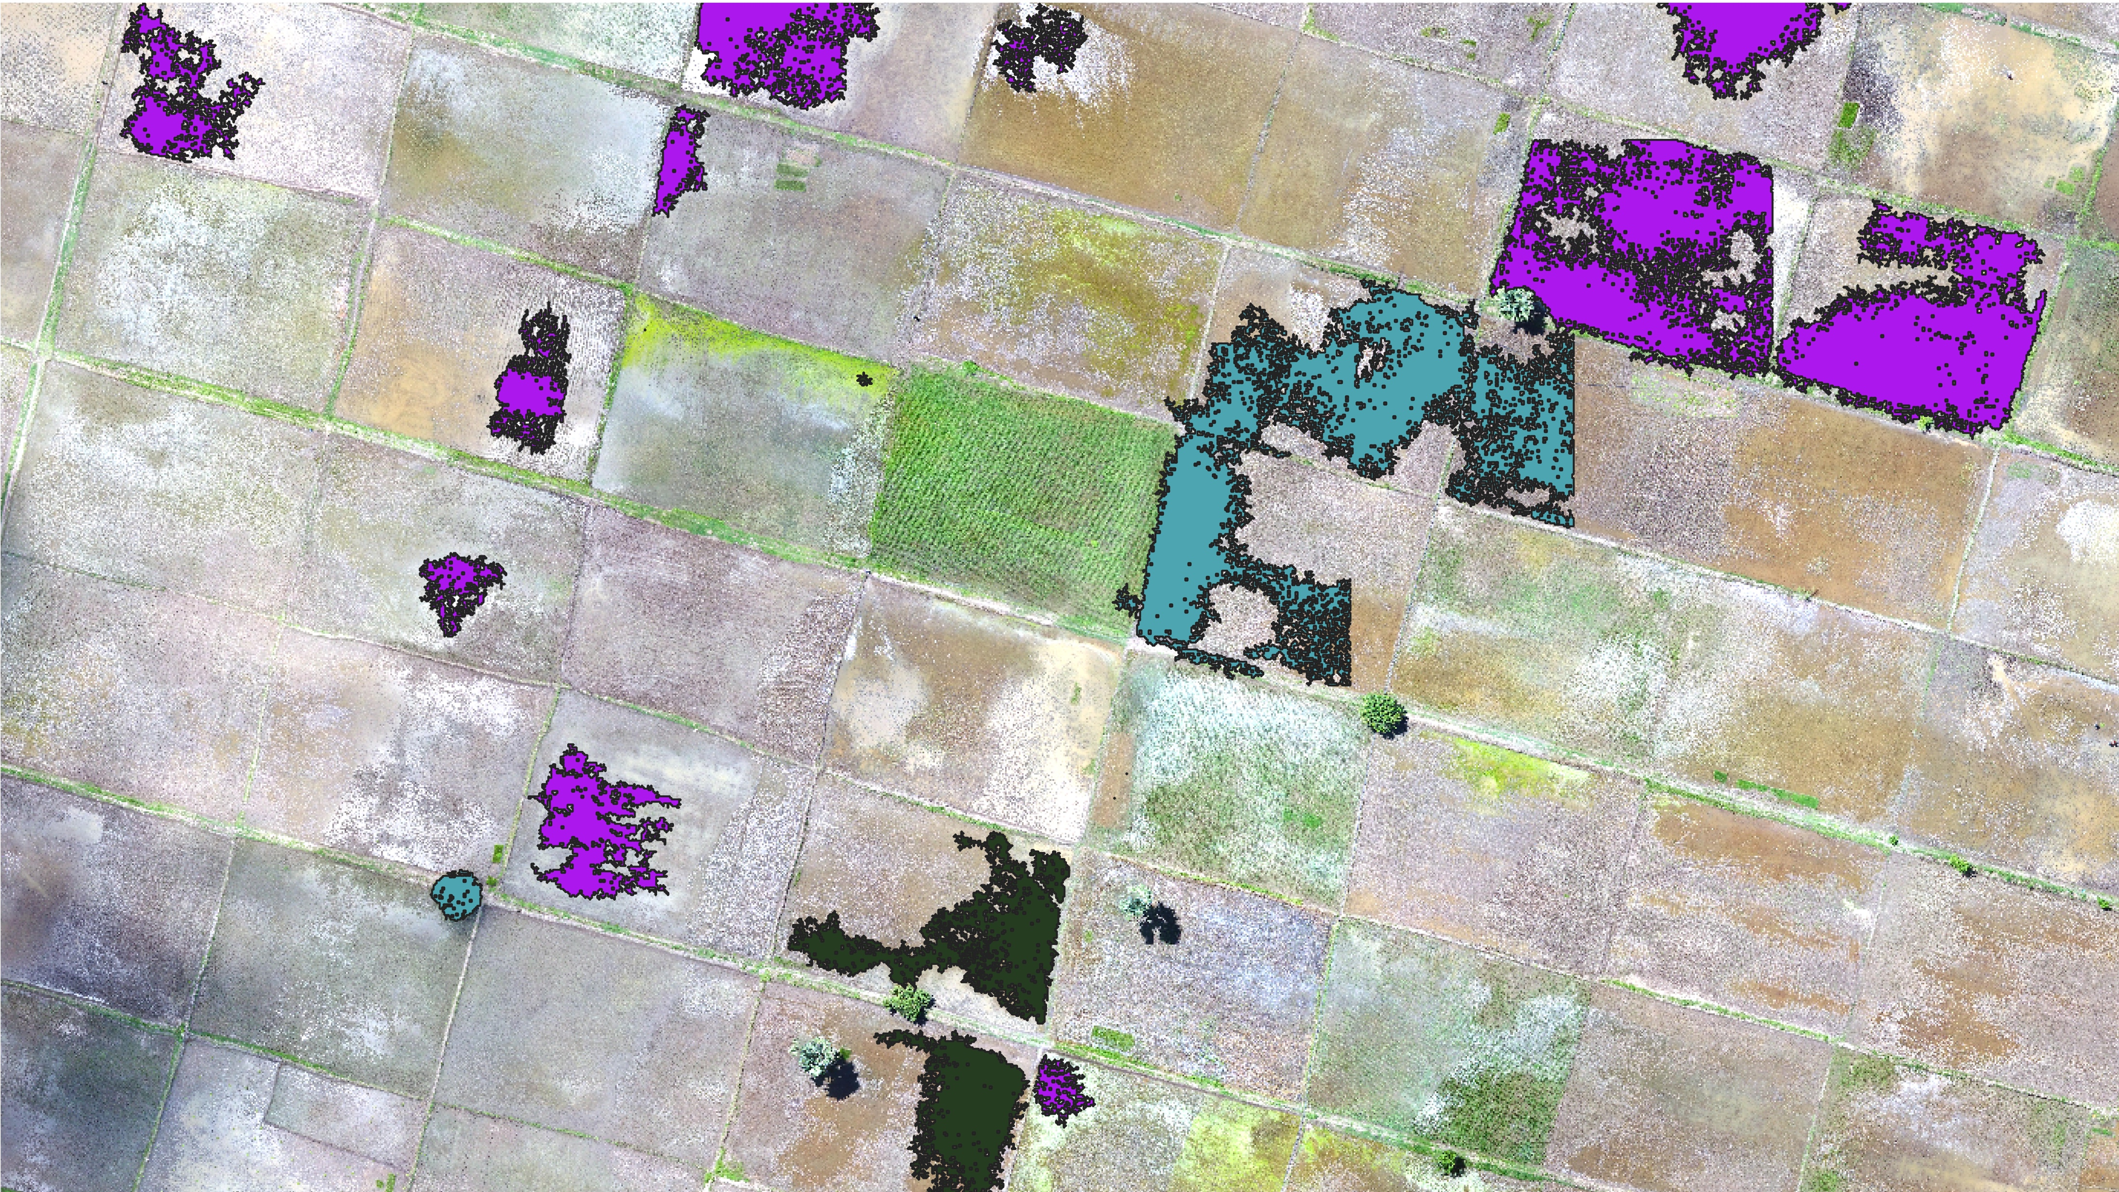

The Region Growing Plugin
Greg Oakes

Slide 2
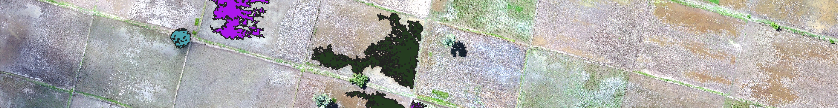
Purpose
The purpose of this QGIS Plugin is to allow a user to click anywhere within an RGB drone image and similarly coloured pixels will automatically selected.
This provides a quick and easy way to generate training data which can be used for image classification.

Slide 3
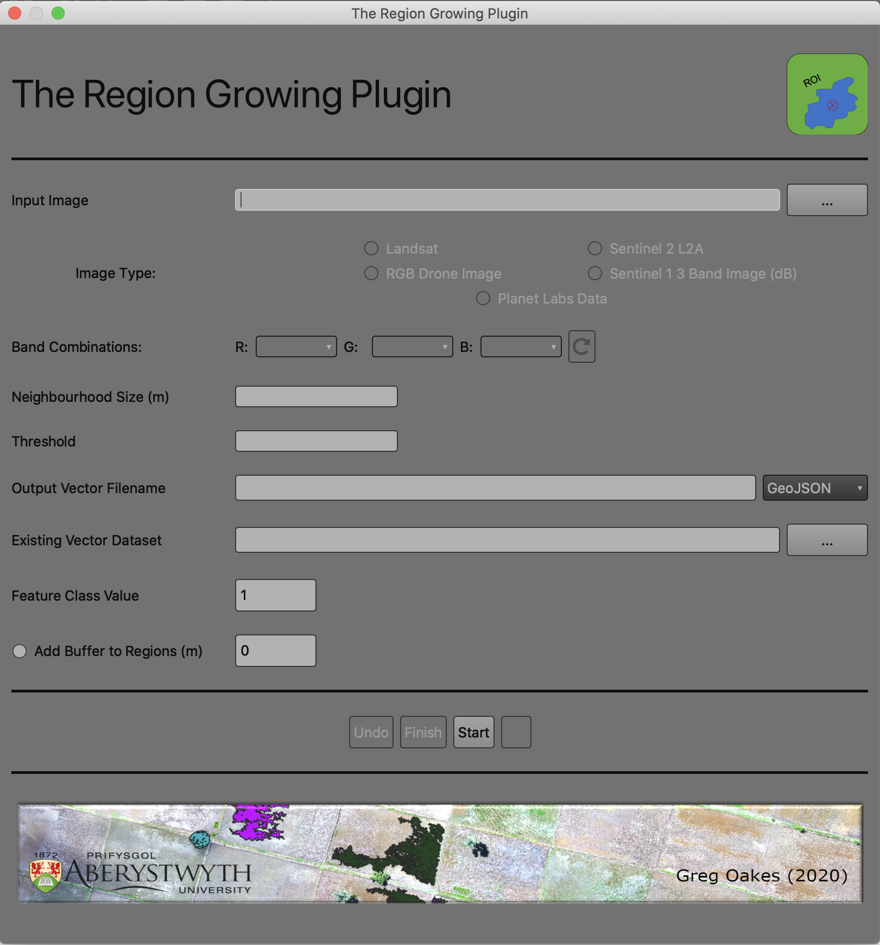
Main User Interface
Select Input Imagery
Input Image Type, Either RGB Drone Image, Sentinel 1 3 band image (usually VV, VH and VV/VH), or multispectral optical (Landsat, Sentinel 2 or PlanetLabs)
Band combination selection for multiband optical imagery. This can be dynamically updated
Like Pixel Threshold, a higher value will include more dissimilar pixels, a lower value gives a stricter selection of like pixels.
Size of the neighbourhood to grow around the clicked point to search for like pixels. A suggested Neighbourhood size is automatically entered when an image type is selected
An existing shapefile that you have started to digitise.
Output Vector filename. This will be saved ion the same directory as the input imagery.

Slide 4

Main User Interface
Class value to add to the attribute table of the output dataset for the next feature to be digitised.
Create the final dataset and close plugin.
Start the region growing plugin.
Add an optional buffer to each feature of a specified distance.
Reactivate Point and Click Tool.
Remove the previous feature.

Slide 5
Map Navigation
The Map can be navigated using the keyboard arrow keys and the zoom level changed by using the mouse scroll wheel.
If you use the QGIS navigation tools in the toolbar you will deactivate the plugin map clicking tool, this can be reactivated by clicking the “Reactivate Point Click Tool”

Slide 6
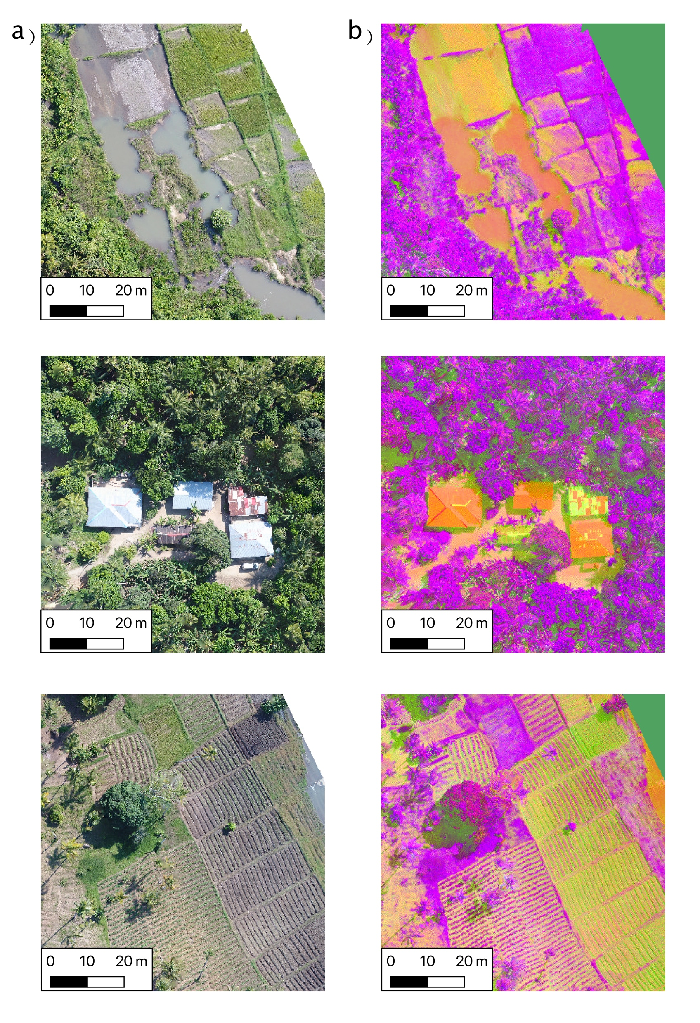
Principle Of Operation for Drone Imagery – LAB Colour Transformation
RGB drone imagery is transformed into an LAB colour space, but still displayed to the user as RGB
An LAB colour space allows for each pixel to be represented in an XYZ coordinate system.
The LAB colour space is different to RGB as pixels values are a component of:
L = Lightness between 0 - 100
A = Position on a Green – Red Spectrum
B = Position on a Yellow – Blue Spectrum

Slide 7
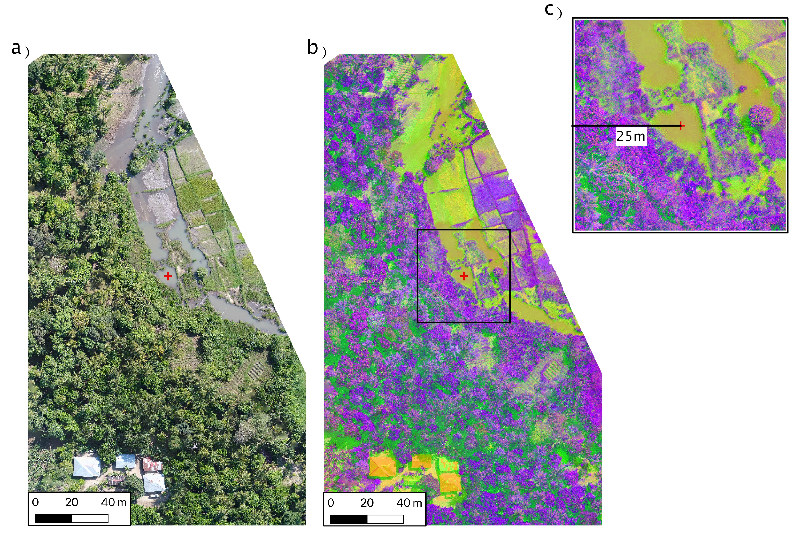
Principle Of Operation for Drone Imagery – LAB Colour Transformation
When a user clicks the map a subset of the LAB image is formed.
The size of the window is defined by the user.
In this window is where like pixels will be found.

Slide 8
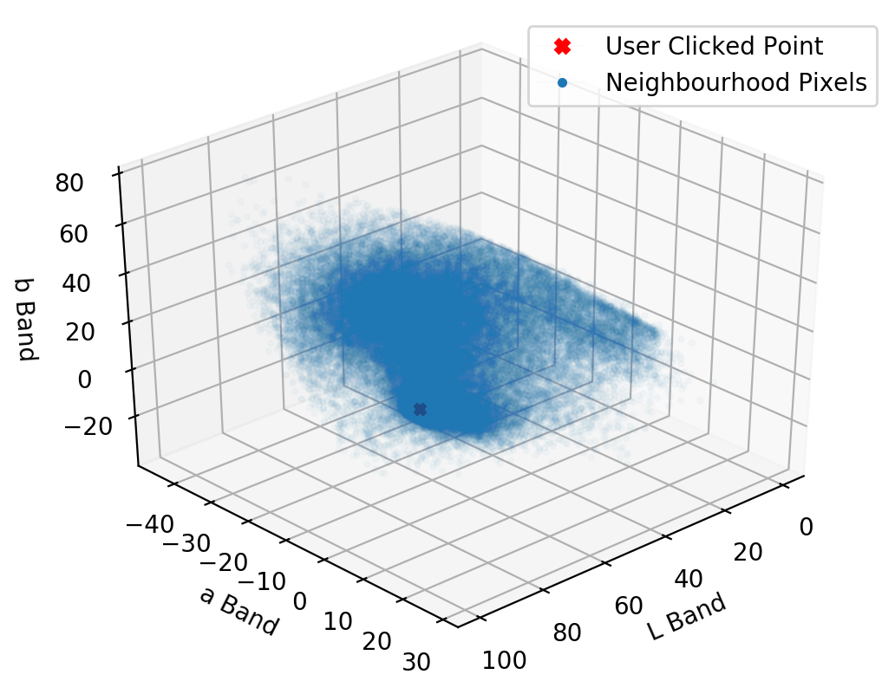
Principle Of Operation Drone Imagery – LAB Feature Space
All pixels within the neighbourhood window are then plotted into an LAB feature space.
The LAB values of the pixel clicked by the user is also plotted.
The Euclidean distance between each pixel in the feature space and the pixel clicked by the user is calculated.

Slide 9
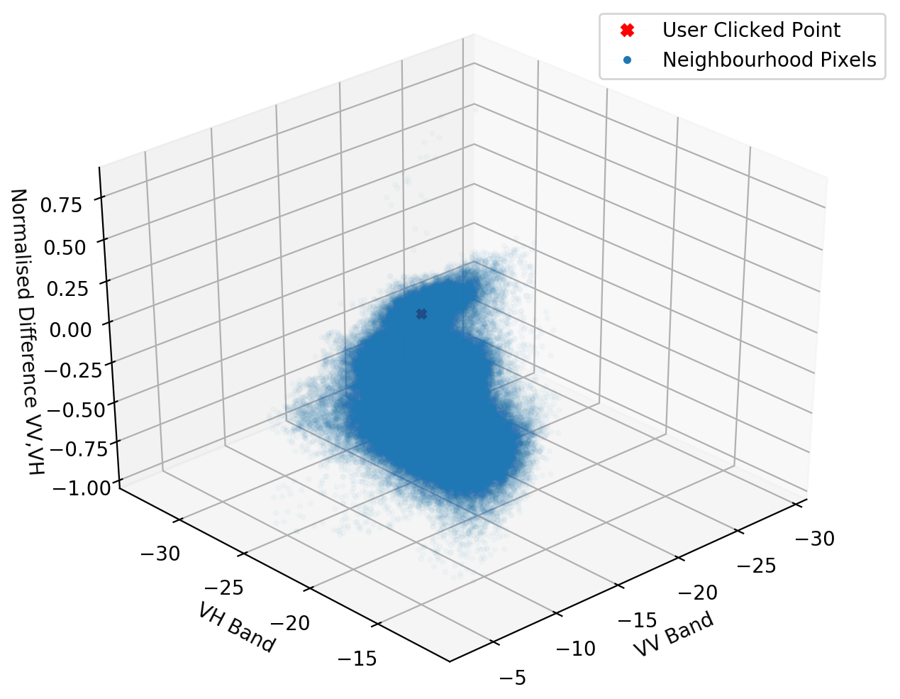
Principle Of Operation Radar and Multispectral Imagery – Pixel Value Feature Space
For radar and multispectral data the pixel values are already expressed as floating point numbers which can be expressed in an XYZ feature space.
These pixel values do not need to be transformed into a different colour space.
The Euclidean distance between each pixel in the feature space and the pixel clicked by the user is calculated.

Slide 10
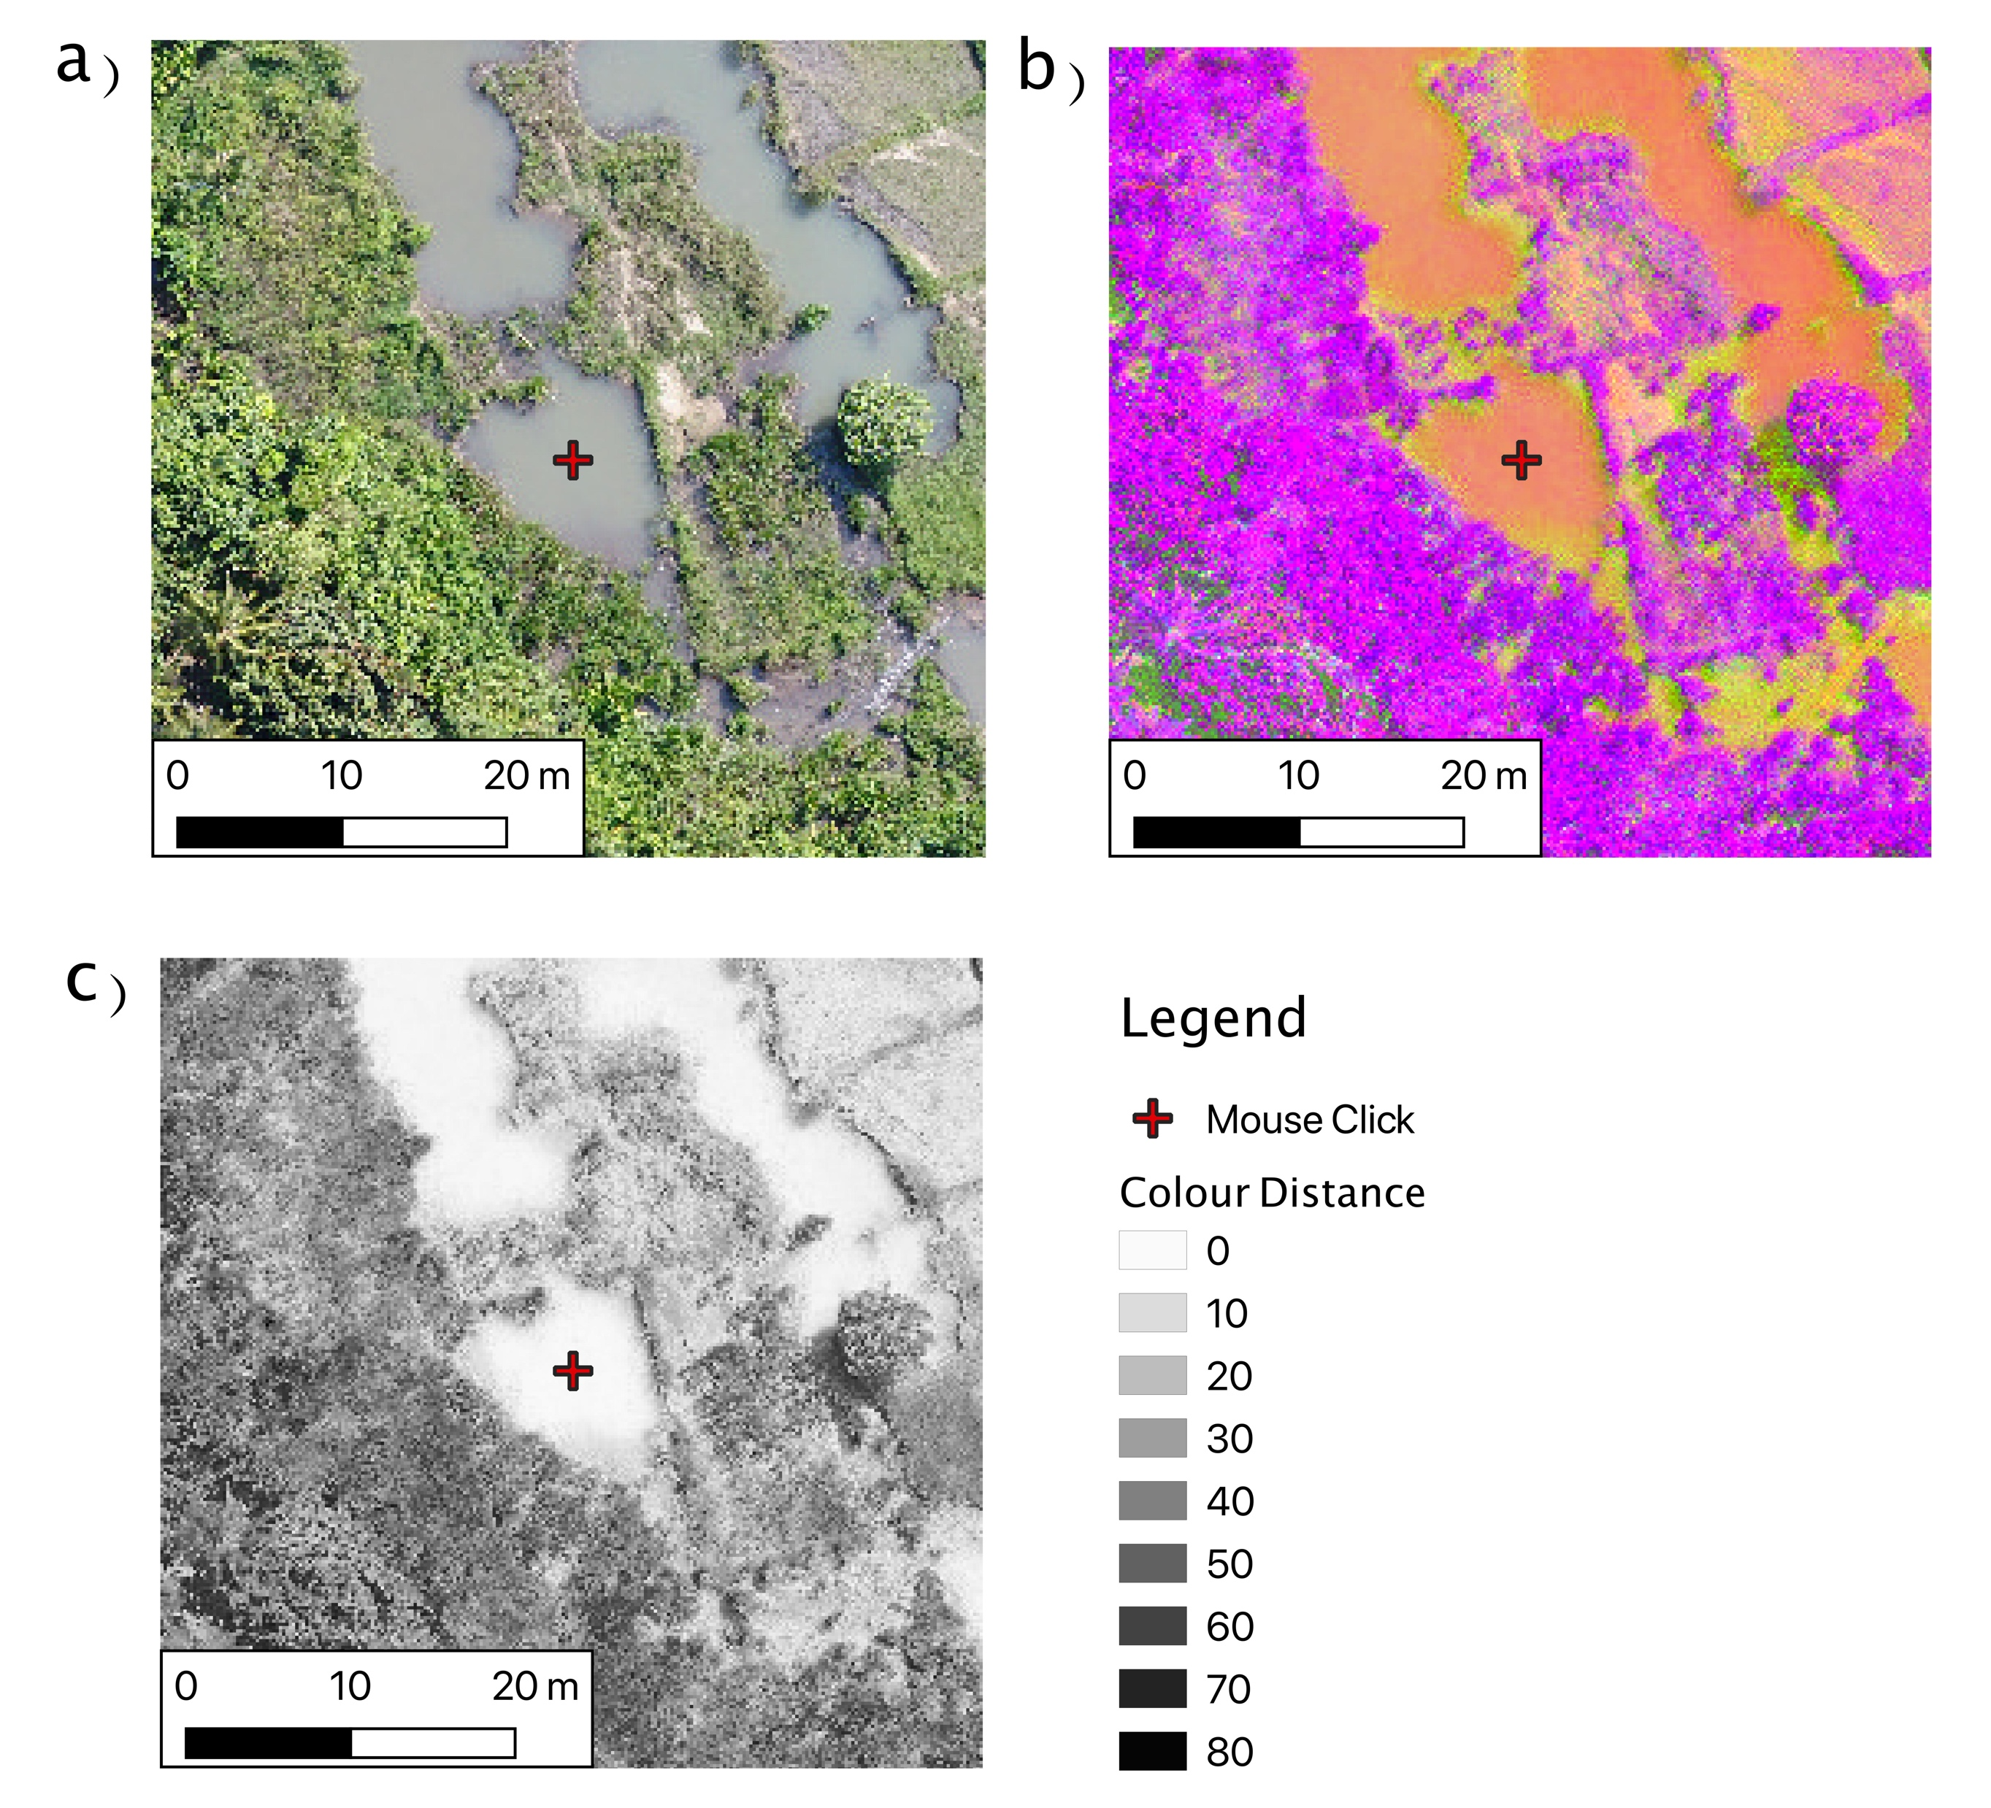
Principle Of Operation – Colour Distance
Pixels which have a similar colour will be expected to appear close to the user clicked pixel in the feature space.
These similar pixels will therefore have a low colour distance.
This is independent of where those pixels are spatially within the neighbourhood window.

Slide 11
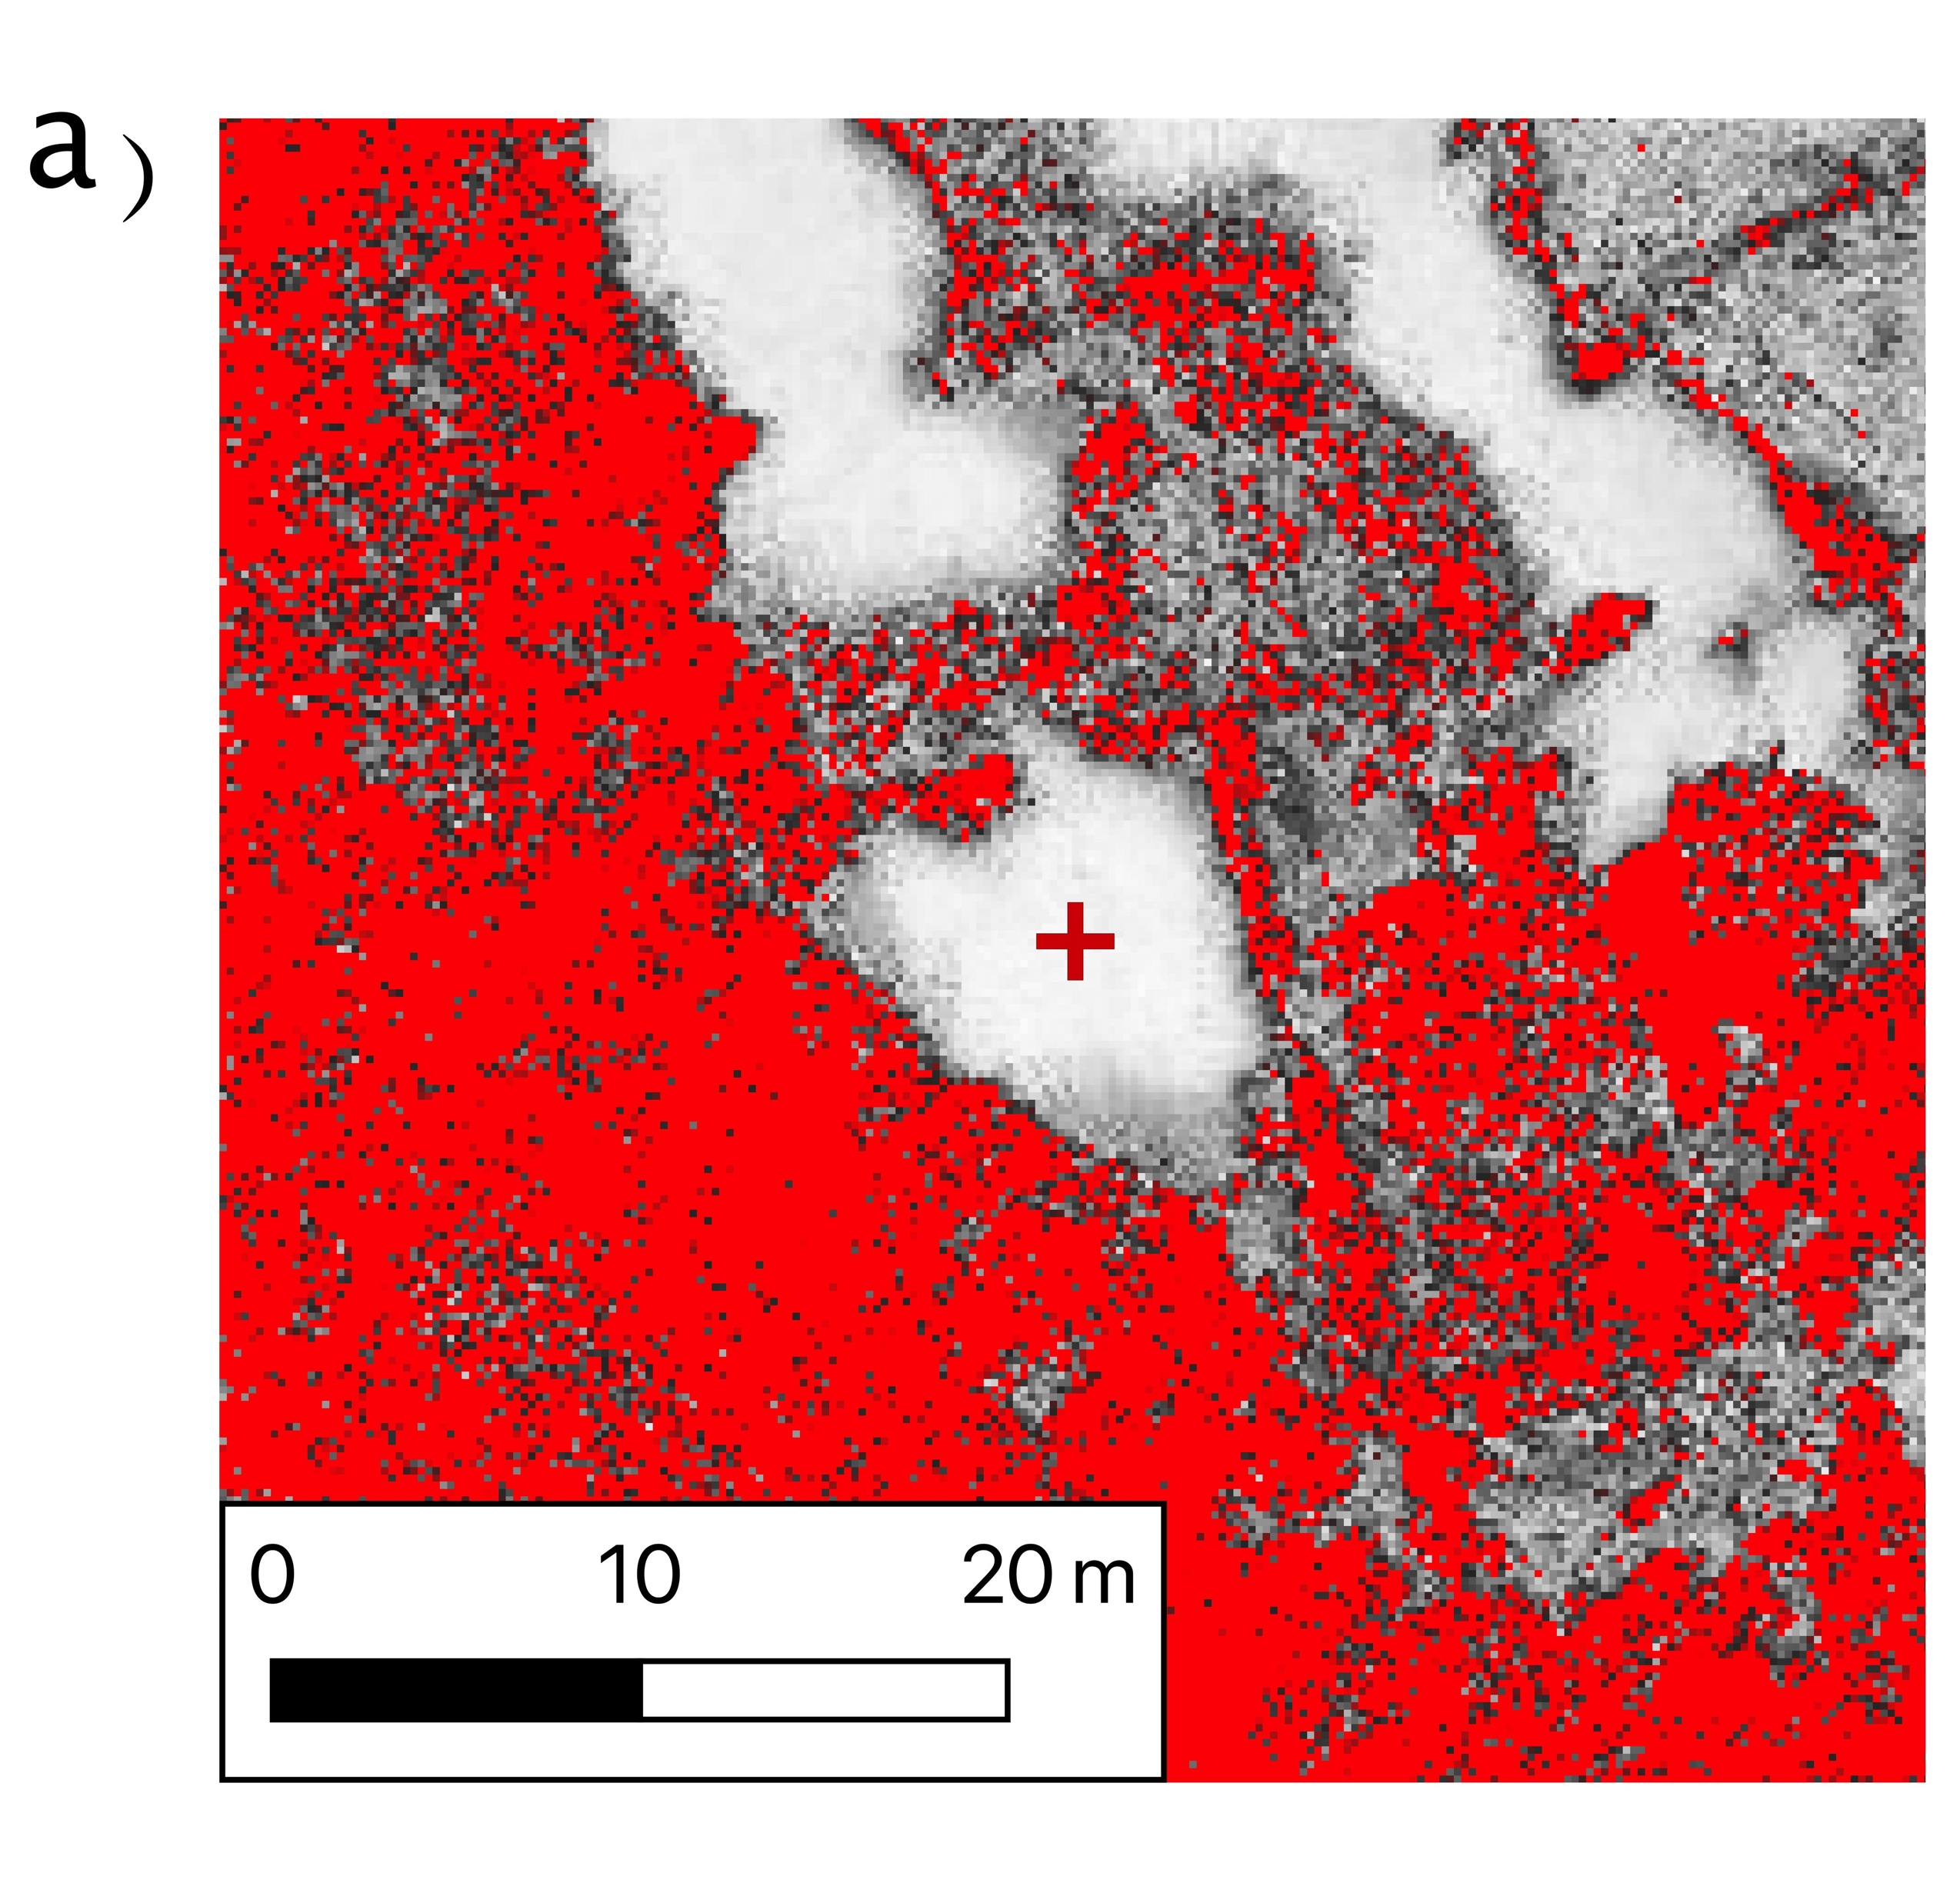
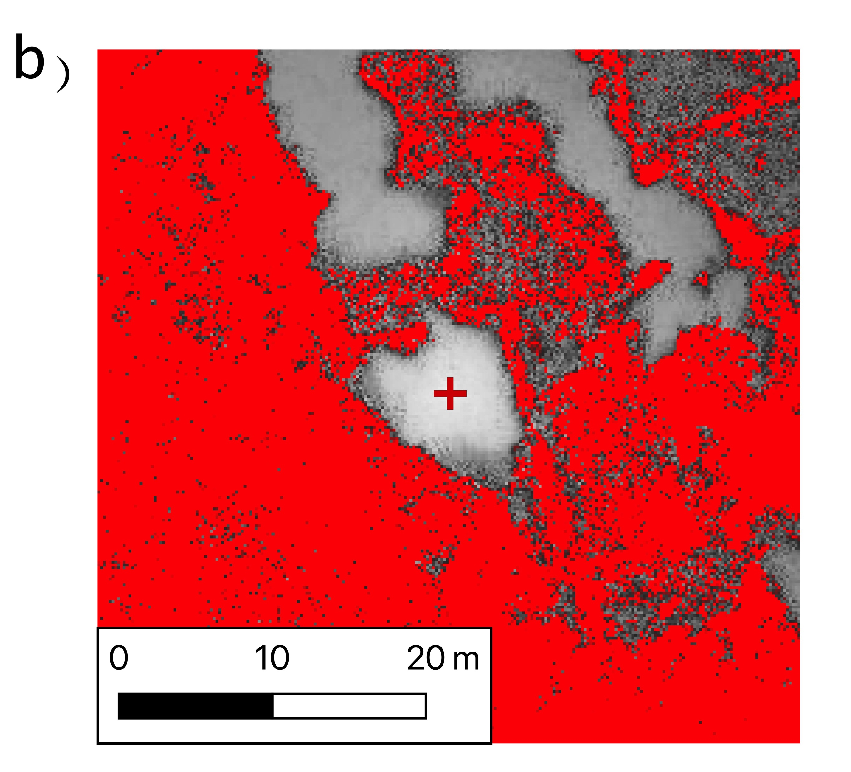
Principle Of Operation – Spatial Weighting
Pixels are spatially weighted based on far away they are from the user clicked pixel.
Pixels further away from the user’s click, which may be a similar colour but a different object have their colour distance increased.
Negatively Weighted Colour Distance

Slide 12
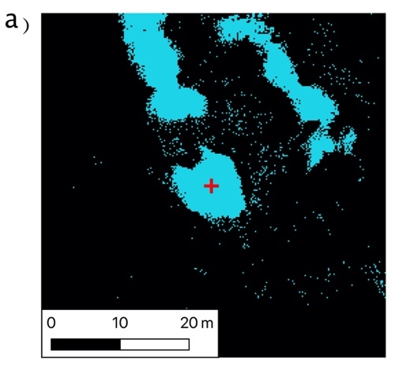
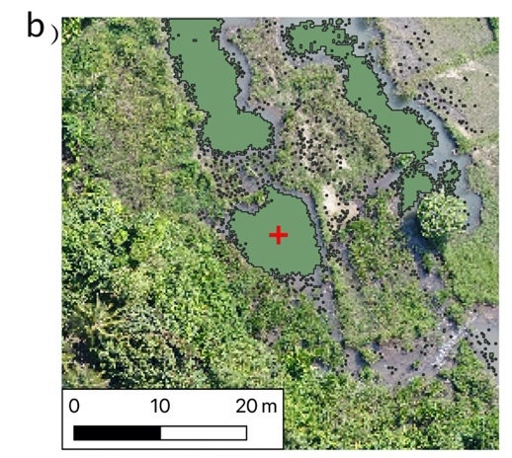
Principle Of Operation – Colour Distance Thresholding
The colour distance image has a user defined threshold applied to determine pixels which are similar after weighting.
The user defined threshold value determines how like or unlike pixels need to be to be considered as one feature.
The threshold Value is dependent on the input imagery.

Slide 13
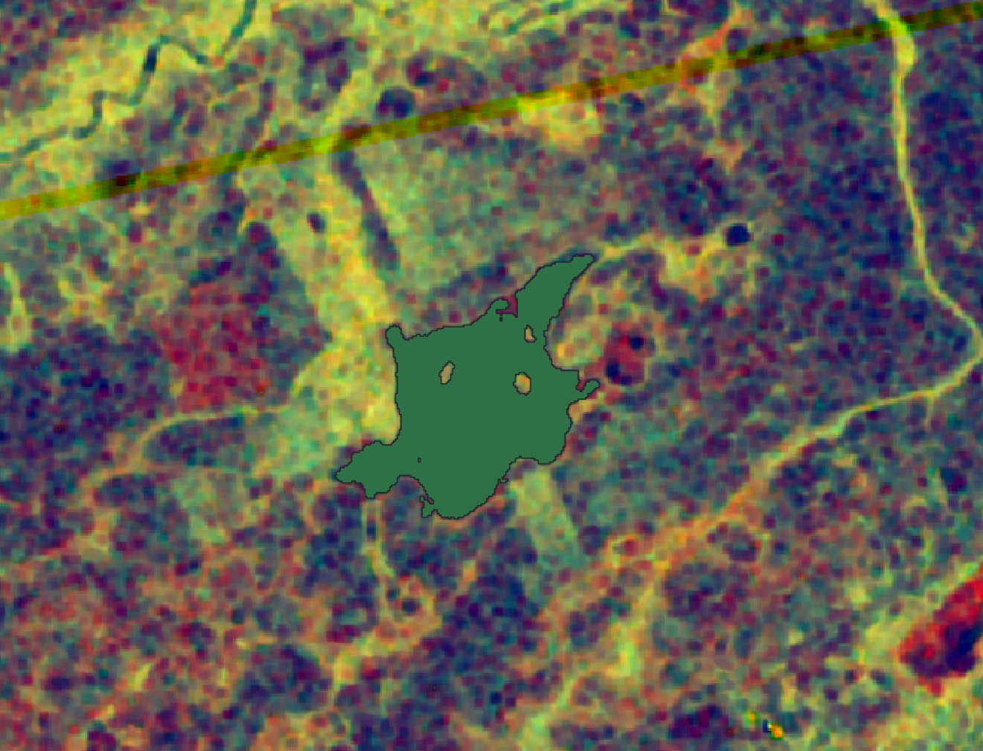
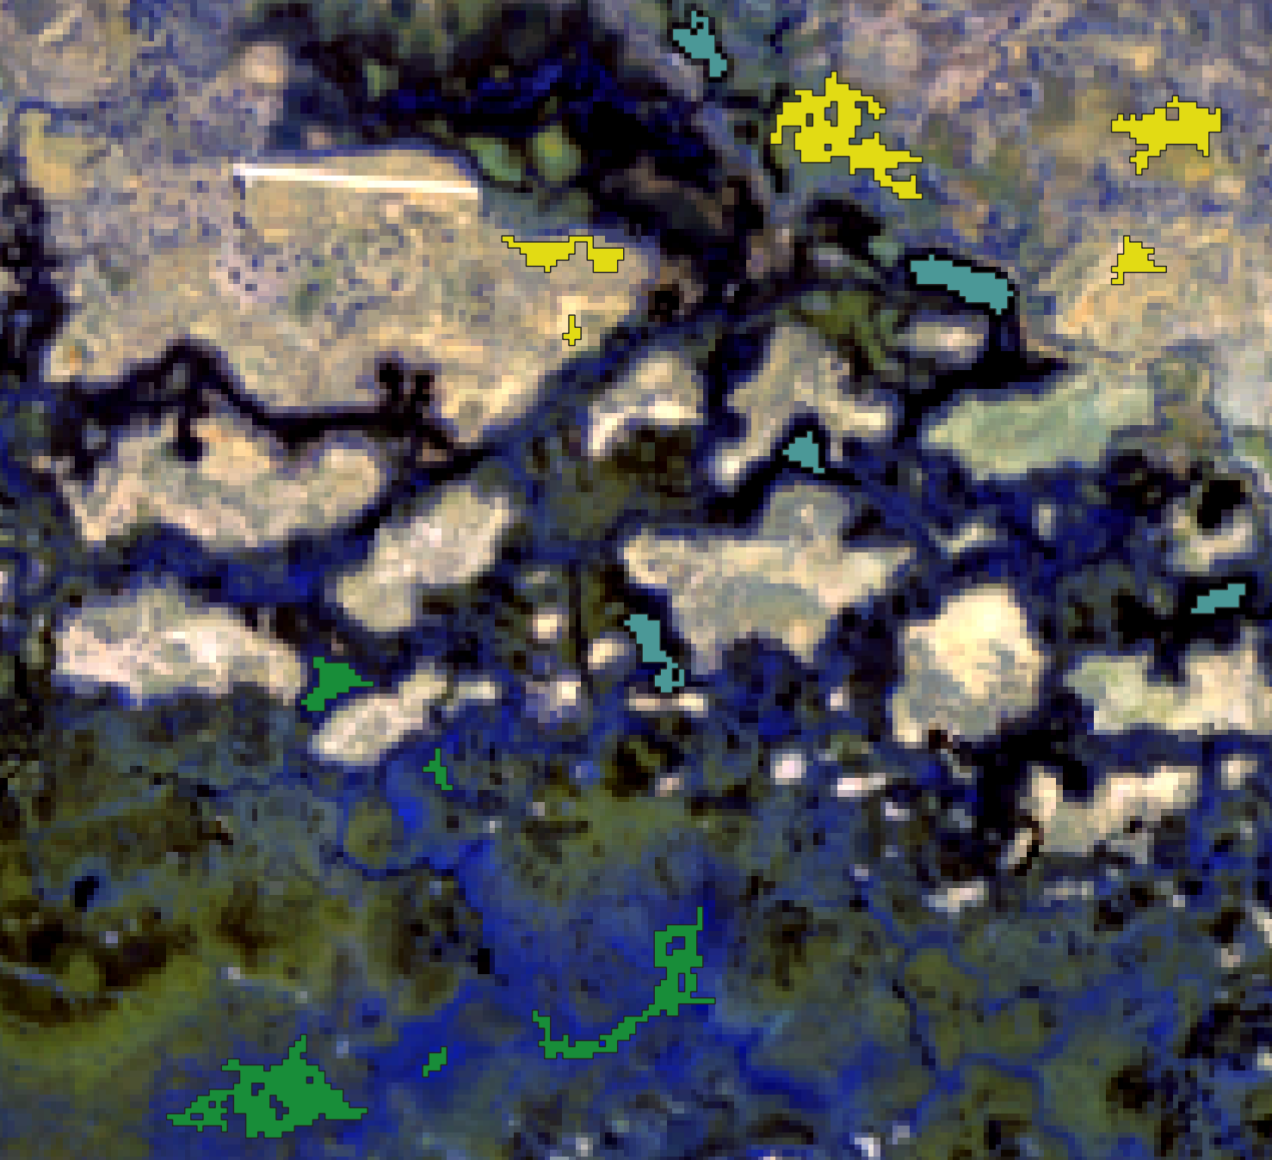
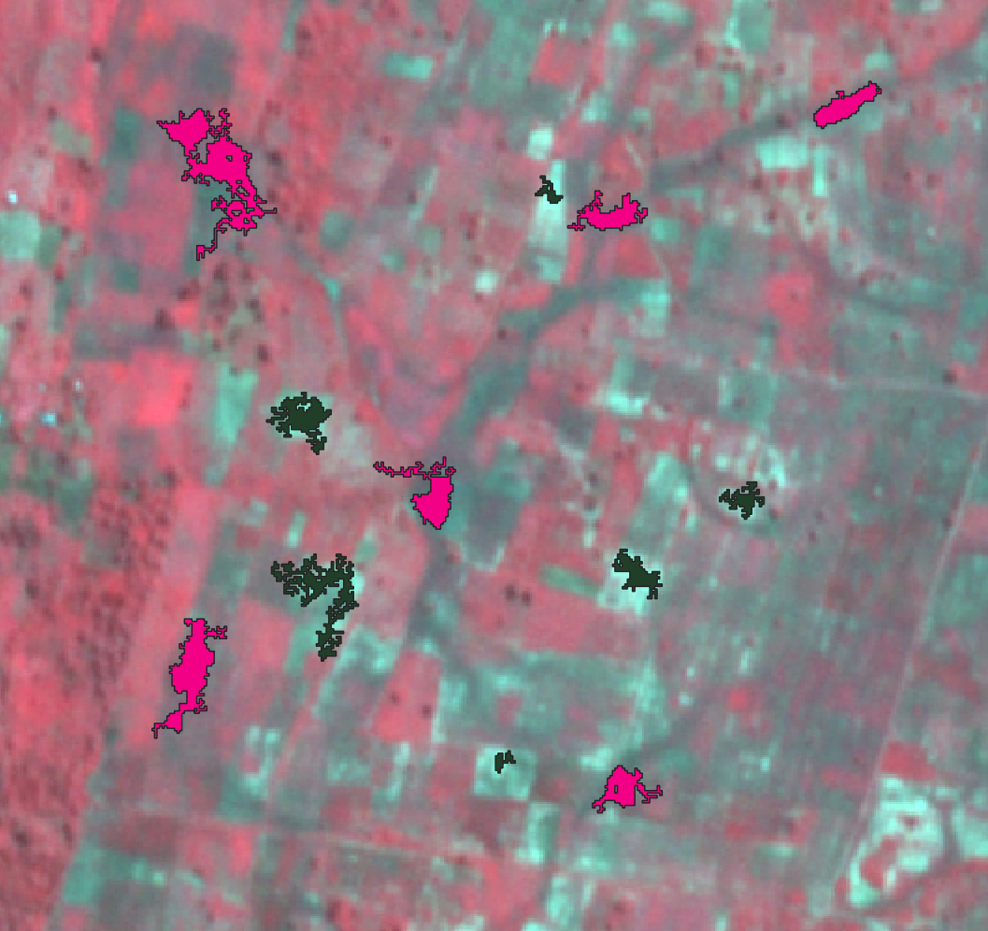
Principle Of Operation – Colour Distance Thresholding
The range of pixel values in the input image determines the threshold value which should be used, and a suggestion is automatically provided.
Sentinel 1 - 15
Landsat 8 - 300
Planet Labs – 175

Slide 14
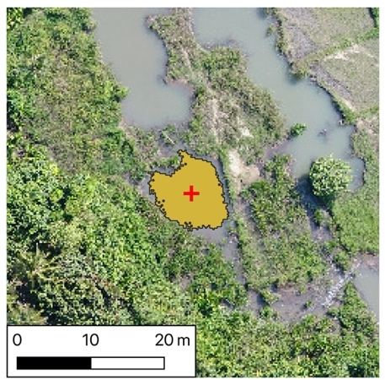
Principle Of Operation – Vector Dataset Intersection
The plugin will commonly identify many objects, containing similar pixels, as well as some single pixels.
To remove these an intersection is made between the user clicked point and the vector dataset.
These leaves a digitised feature at the location the user has clicked containing similarly coloured pixels.

Slide 15
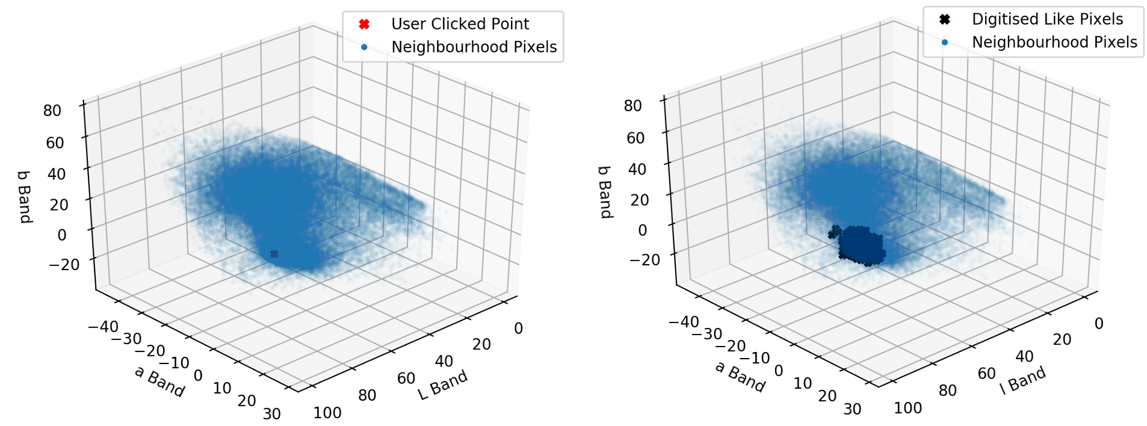
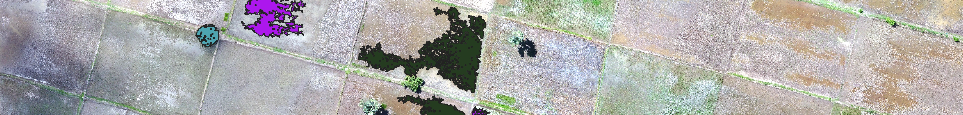
Identified Pixels in the LAB Feature Space
Pixels which have been digitised with the tool can be seen to cluster around the location of the user’s mouse click.

